Slide 1
Explainability Milestone 5: Trade-offs and Interactions with other verticals in Trustworthy AI
Roseline Polle
Postgraduate, UCL
roseline.polle.19@ucl.ac.uk
Notes:
Assessing and Mitigating Bias and Discrimination in AI
Part I: Ethical, Legal, and Governance aspects of AI Bias and Discrimination
Part II: Technical dimensions of Bias and Discrimination in Supervised Machine Learning

Slide 2
1. Intro on Explainability

Slide 3
Interpretability/Explainability
Interpretability: "the degree to which a human can understand the cause of a decision“ [Miller, 2018]
Explainability: the degree to which the inner mechanics of an algorithm are understood by a human

Slide 4
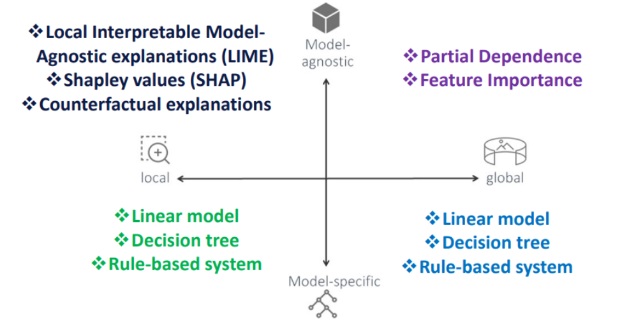
Types of Explainability
[Koshiyama et al.,2021]

Slide 5
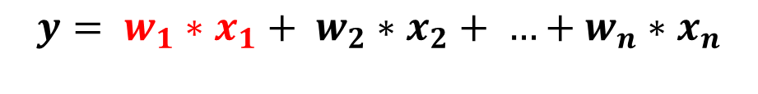
Feature importance
Looks to assign a score to each feature relative to its importance in the prediction.
Simple example in linear regression:
$$y= w_{1}∗x_{1}+ w_{2}∗x_{2}+ …+w_{n}∗x_{n}$$
Importance of feature 1 in outcome y

Slide 6
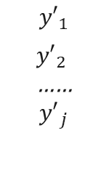
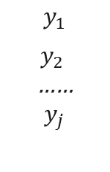
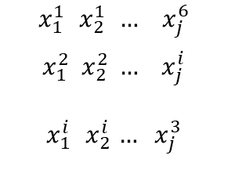
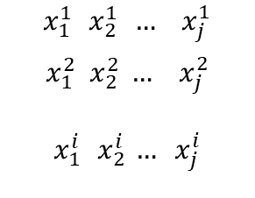
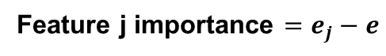

Permutation feature importance
Feature j
Input matrix X
$$x_{1}^{1}{ x}_{2}^{1} … { x}_{j}^{1}$$
$$x_{1}^{2} x_{2}^{2} … { x}_{j}^{2}$$
$$x_{1}^{i}{ x}_{2}^{i} … x_{j}^{i}$$
$$y_{1}$$
$y_{2}$
……
$$y_{j}$$
model
error e
…
Candidate i
Permute feature n
Feature j importance $=e_{j}−e$
$$x_{1}^{1}{ x}_{2}^{1} … { x}_{j}^{6}$$
$$x_{1}^{2} x_{2}^{2} … { x}_{j}^{i}$$
$$x_{1}^{i}{ x}_{2}^{i} … x_{j}^{3}$$
$${y′}_{1}$$
${y′}_{2}$
……
$${y′}_{j}$$
Matrix X’
model
error $e_{j}$
…

Slide 7
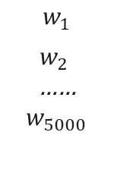
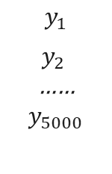
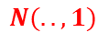
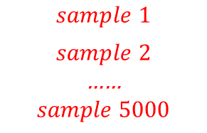
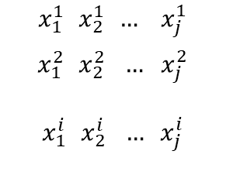
LIME
Explain results for candidate i:
Sample 5,000 times feature vector i using a normal distribution
Predict output
Assign weight base on distance
Feature selection (Lasso)
Input matrix X
$$x_{1}^{1}{ x}_{2}^{1} … { x}_{j}^{1}$$
$$x_{1}^{2}{ x}_{2}^{2} … { x}_{j}^{2}$$
$$x_{1}^{i}{ x}_{2}^{i} … x_{j}^{i}$$
…
Candidate i
$$y_{1}$$
$y_{2}$
……
$$y_{5000}$$
$$N(..,1)$$
model
Feature j
$$sample 1$$
$$sample 2$$
……
$$sample 5000$$
Feature importance on output
…
$$w_{1}$$
$w_{2}$
……
$$w_{5000}$$
Weight based on distance

Slide 8
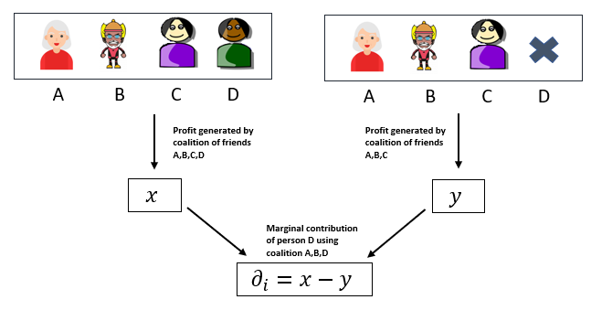
SHAPLEY Values
Adapted from https://towardsdatascience.com/shap-shapley-additive-explanations-5a2a271ed9c3 by Fernando Lopez

Slide 9
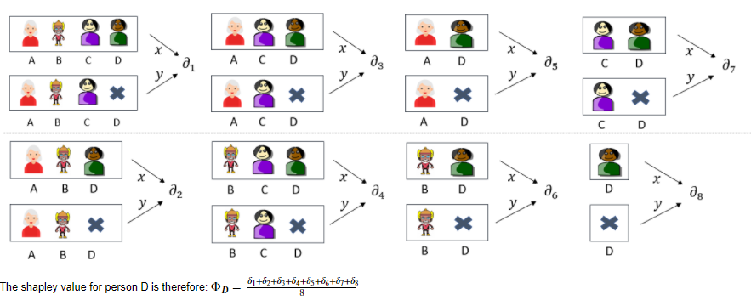
SHAPLEY Values

Slide 10
2. Interactions with Fairness

Slide 11
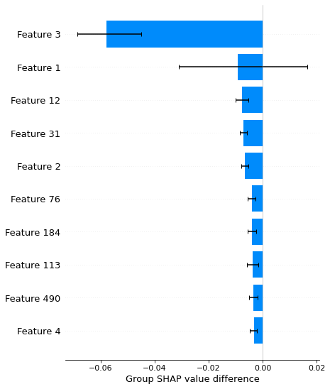
Questions one can answer
Are the most influential factors reasonable? Are they proxy for a protected characteristics?
Is the model relying too much on one feature?
Are they the influential factors the same across different groups ?

Slide 12
Adaptation to fairness
Instead of explaining output → explain fairness metric
Example: effect of permutation importance on Disparate Impact metric.
Answers the question: what are the features most responsible for the observed bias (if any) ?

Slide 13
Further readings
Interpretable Machine Learning. A Guide for Making Black Box Models Explainable (https://christophm.github.io/interpretable-ml-book/)

